Slide 1
MOLECULAR ORBITAL THEORY
BY F.HUND AND R.S. MULLIKEN

Slide 3
POSTULATES OF MOLECULAR ORBITAL THEORY
The atomic orbital combine (overlap) to form a new orbital known as molecular orbital. As a result, the atomic oritals loose their identity.
The molecular orbital are the energy states of a molecule, in which the electrons of the molecule are filled just like in case of atomic orbital.
An M.O gives electron probability distribution around a group of nuclei (as M.O always contain two nuclei) same as the atomic orbital.
Only that A.Os is combined to form M.Os which have comparable energy, and orientations. For ex: 1s can combine with 1s and not with 2s as they have energy gap. Similarly, s-orbital can combine with p_{z} but not with p_{x} or p_{y} as the z-axis is inter nuclear axis and so oriented in line of s-orbital but others are perpendicular.
The no. of M.Os formed are equal to the no. of A.Os combined.
When two A.Os combine, they form two M.Os known as bonding molecular orbital (B.M.O) and antibonding molecular orbital (A.M.O) .
The, B.M.O has lower energy and hence greater stability than the corresponding A.M.O.
The B.M.Os are represented by σ,π,δ etc. while antibonding M.Os are represented by σ* ,π* ,δ* etc.
The shapes of molecular orbitals depend upon the type of combining atomic orbital.
The filling of M.Os takes place by same rule as for atomic orbitals. Like they follow, Aufbau, Pauli exclusion, and Hund'e rule.

Slide 4
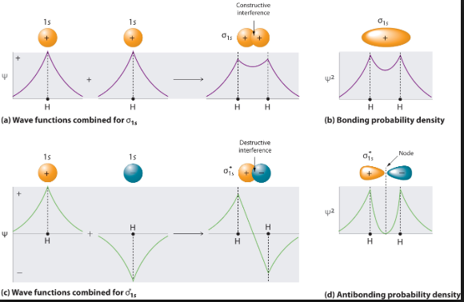

Slide 7
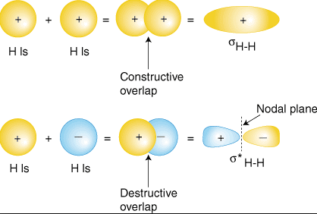
BONDING AND ANTIBONDING ORBITAL

Slide 8
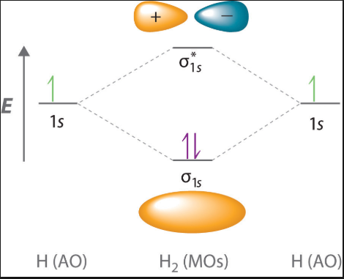

Slide 9
MOLECULAR ORBITALS IN HELIUM

Slide 10
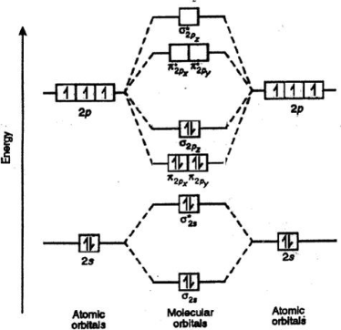
ELECTRONIC CONFIGURATION OF NITROGEN MOLECULE

Slide 11
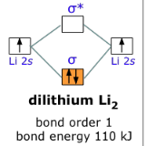
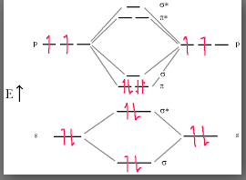
DICARBON C2

Slide 12
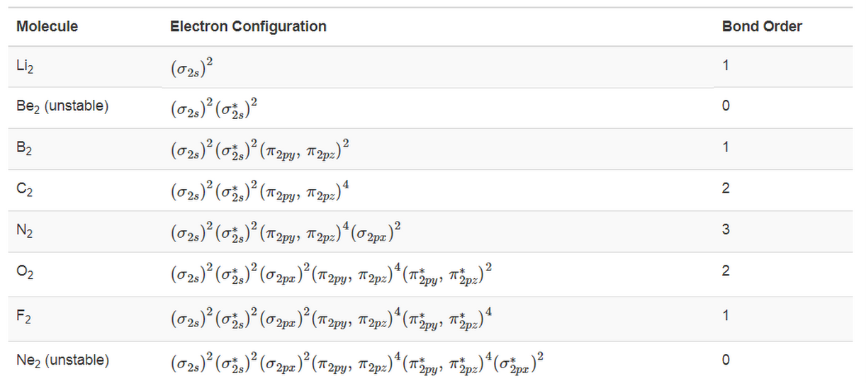

Slide 15
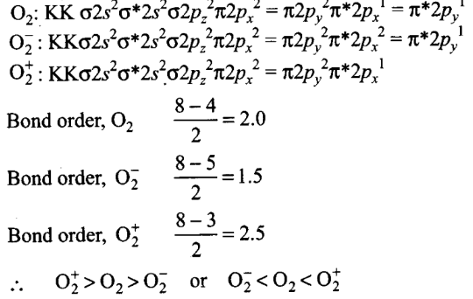

Slide 16
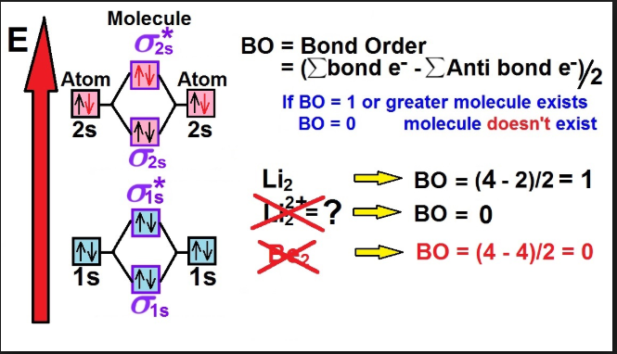

Slide 17
Example 1
Determine the bond order of C2 molecule.
Solution
Step 1. Write the electronic configuration of C2 molecule.
Electronic configuration of C2
= (σ1s)2 (σ*1s)2(σ2s)2(σ*2s)(π2px2 π2py2)
Step 2. From the above electronic configuration, put the values in the formula
Bond order = Nb – Na / 2
= 6 – 2 / 2
= 2

Slide 18
xample 2
Determine the bond order of hydrogen molecule (H2).
Solution
Step 1. Write the electronic configuration of Hydrogen atom
The electronic configuration of hydrogen is (σ1s)2
Step 2. Put the values from the above electronic configuration in the bond order formula, we get
Bond order = 2 – 0 / 2
Therefore, bond order = 1
It means single covalent bond exist in H2 molecule, and diamagnetic since there is no unpaired electron.

